Slide 1
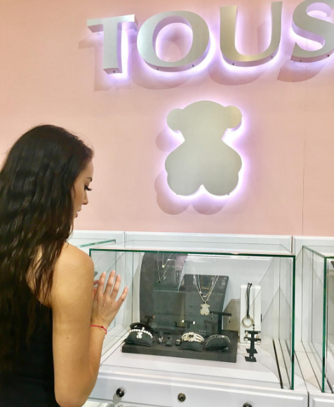
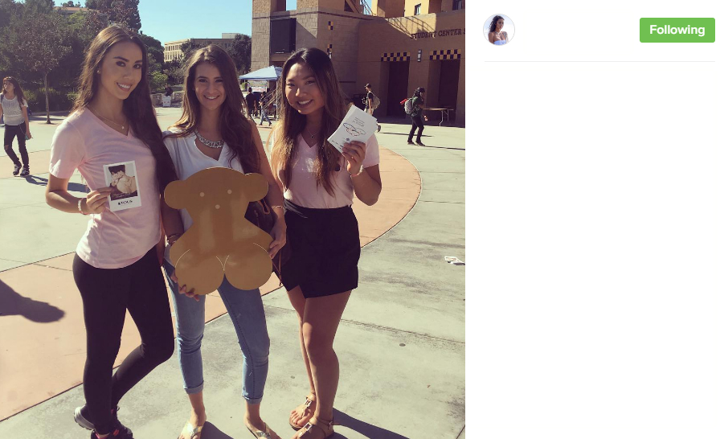
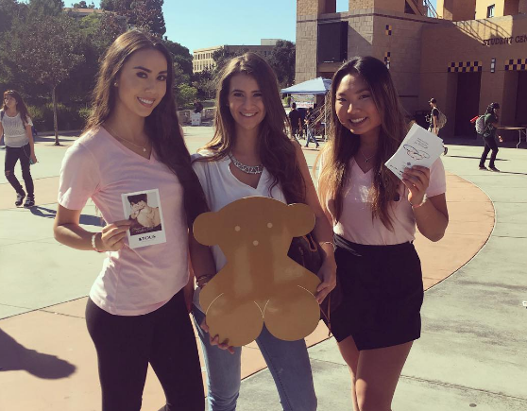
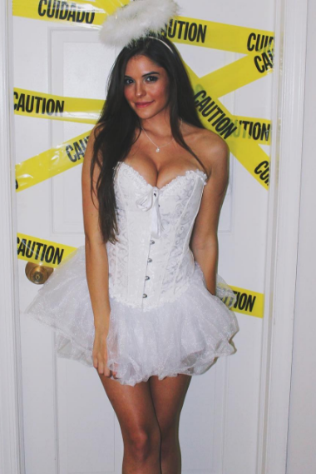

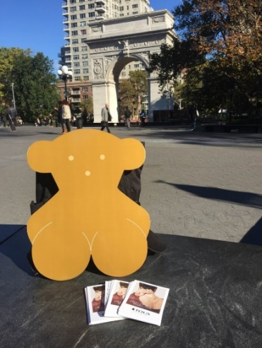
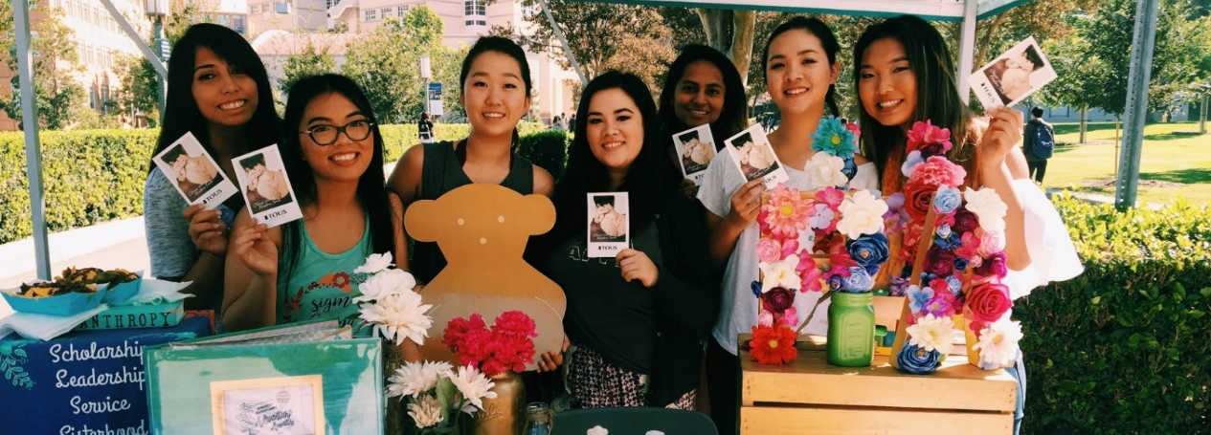
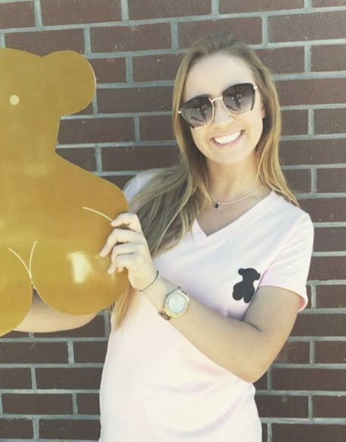
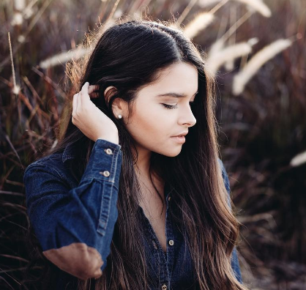
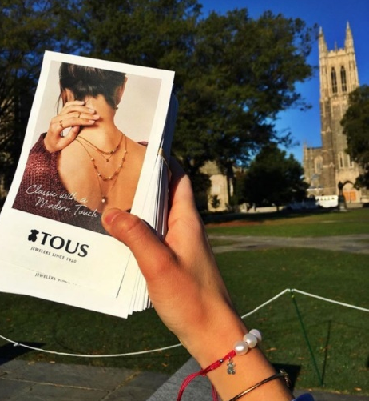
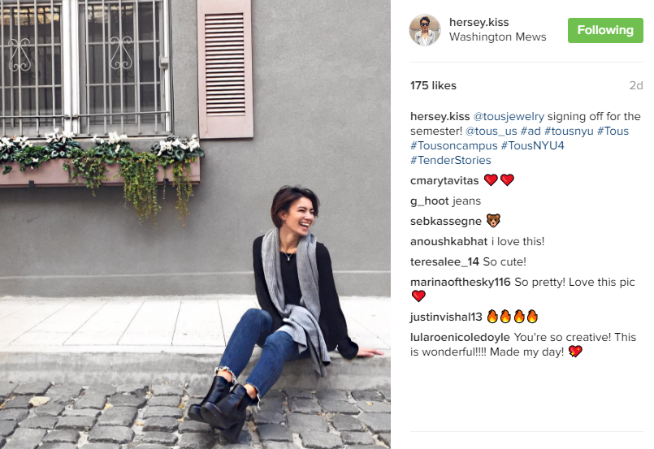
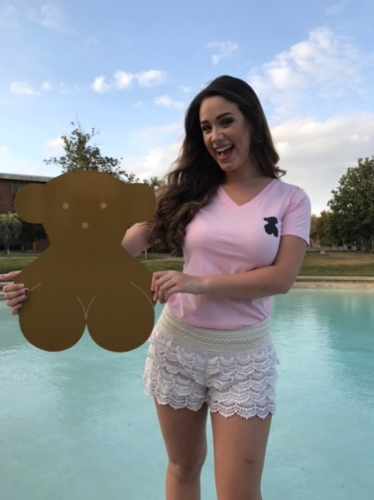
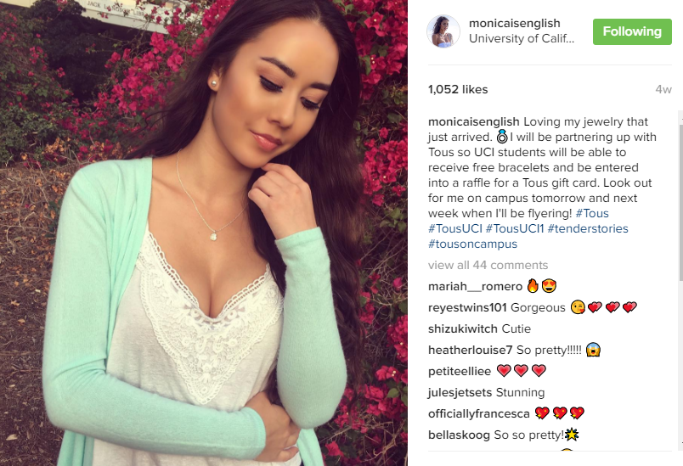


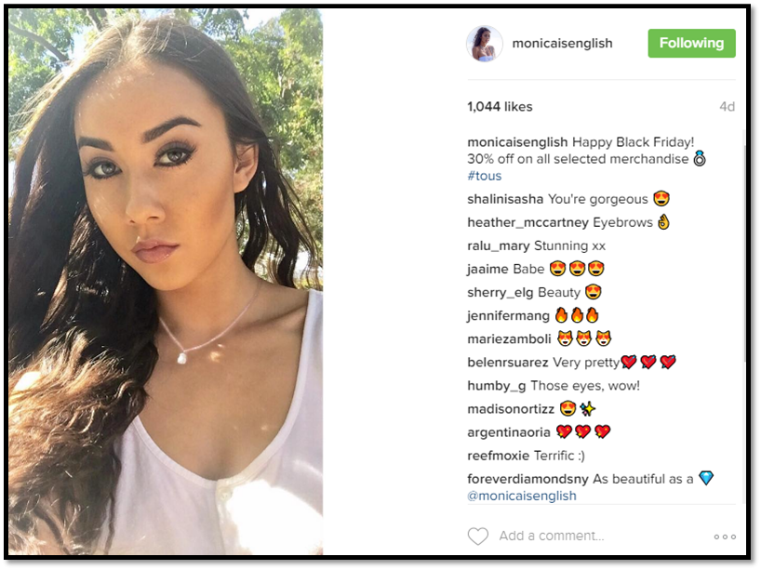

oncampus_advertising
Social Media, Flyering, Postering, Email
32,048 likes on instagram
1,526 likes on facebook
oncampus_advertising The female jewelry and accessory company, Tous, was looking to drive student traffic to stores around 6 universities. #UniversityofCalifornia-Irvine #NewYorkUniversity #DukeUniversity #UniversityofMaryland #UniversityofCentralFlorida #UniversityofMiami
goal Raise brand awareness and drive student traffic to Tous retailers and Tous.com
timeframe 10/25 – 12/31/16
media_plan OnCampus designed a plan that combined our Campus Influencers, who promoted Tous by posting on social media, handing out flyers and hanging up posters, with targeted email blasts to female students at select schools. social_media 22 social influencers, 124 social media posts
physical_distribution 13,200 flyers distributed, 1,700 posters installed
emails 158,151 emails sent with a 39% Open Rate #Amazing
heatherlouise7 So pretty!!!!!
de_juwelier_Utrecht Lovely post
Nicholesantana OMG I’ll be there!!!
sebkassegne Your necklace
jennamontag Can I get some?
marinaofthesky116 So pretty! Love this pic!
skynance I LOVeee Tous
tous_us Lovely! Absolutely stunning!

Slide 2

oncampusadvertising
Social Media, Flyering, Postering, Email
32,048 likes on instagram
1,526 likes on facebook
oncampusadvertising The female jewelry and accessory company, Tous, was looking to drive student traffic to stores around 6 universities. #universityofcaliforniairvine #newyorkuniversity #dukeuniversity #universityofmarylandcollegepark #universityofcentralflorida #universityofmiami
goal Raise brand awareness and drive student traffic to Tous retailers and Tous.com
timeframe 10/25 – 12/31/16
media_plan OnCampus designed a plan that combined our Campus Influencers, who promoted Tous by posting on social media, handing out flyers and hanging up posters, with targeted email blasts to female students at select schools. social_media 22 social influencers, 124 social media posts
physical_distribution 13,200 flyers distributed, 1,700 posters installed
emailssent 158,151 emails sent
heatherlouise7 So pretty!!!!!
de_juwelier_Utrecht Lovely post
deniseleee Ooohlala may I redeem through the interwebs?
mareethebear Imma find you!
mistahsouza I could use a flyer!
jennamontag Can I get some?
marinaofthesky116 So pretty! Love this pic!
tous_us Lovely! Absolutely stunning!

Slide 3
oncampus_advertising
Social Media, Flyering, Postering, Email
32,048 likes on instagram
1,526 likes on facebook
oncampus_advertising The female jewelry and accessory company, Tous, was looking to drive student traffic to stores around 6 universities. #UniversityofCalifornia-Irvine #NewYorkUniversity #DukeUniversity #UniversityofMaryland #UniversityofCentralFlorida #UniversityofMiami
goal Raise brand awareness and drive student traffic to Tous retailers and Tous.com
timeframe 10/25 – 12/31/16
media_plan OnCampus designed a plan that combined our Campus Influencers, who promoted Tous by posting on social media, handing out flyers and hanging up posters, with targeted email blasts to female students at select schools. social_media 22 social influencers, 124 social media posts
physical_distribution 13,200 flyers distributed, 1,700 posters installed
emails 158,151 emails sent with a 39% Open Rate #Amazing
heatherlouise7 So pretty!!!!!
de_juwelier_Utrecht Lovely post
Nicholesantana OMG I’ll be there!!!
sebkassegne Your necklace
jennamontag Can I get some?
marinaofthesky116 So pretty! Love this pic!
skynance I LOVeee Tous
tous_us Lovely! Absolutely stunning!

Slide 4

oncampus_advertising
Social Media, Flyering, Postering, Email
32,048 likes on instagram
1,526 likes on facebook
oncampus_advertising The female jewelry and accessory company, Tous, was looking to drive student traffic to stores around 6 universities. #UniversityofCalifornia-Irvine #NewYorkUniversity #DukeUniversity #UniversityofMaryland #UniversityofCentralFlorida #UniversityofMiami
goal Raise brand awareness and drive student traffic to Tous retailers and Tous.com
timeframe 10/25 – 12/31/16
media_plan OnCampus designed a plan that combined our Campus Influencers, who promoted Tous by posting on social media, handing out flyers and hanging up posters, with targeted email blasts to female students at select schools. social_media 22 social influencers, 124 social media posts
physical_distribution 13,200 flyers distributed, 1,700 posters installed
emails 158,151 emails sent with a 39% Open Rate #Amazing
heatherlouise7 So pretty!!!!!
de_juwelier_Utrecht Lovely post
Nicholesantana OMG I’ll be there!!!
sebkassegne Your necklace
jennamontag Can I get some?
marinaofthesky116 So pretty! Love this pic!
skynance I LOVeee Tous
tous_us Lovely! Absolutely stunning!

Slide 5
oncampus_advertising
Social Media, Flyering, Postering, Email
32,048 likes on instagram
1,526 likes on facebook
oncampus_advertising The female jewelry and accessory company, Tous, was looking to drive student traffic to stores around 6 universities. #UniversityofCalifornia-Irvine #NewYorkUniversity #DukeUniversity #UniversityofMaryland #UniversityofCentralFlorida #UniversityofMiami
goal Raise brand awareness and drive student traffic to Tous retailers and Tous.com
timeframe 10/25 – 12/31/16
media_plan OnCampus designed a plan that combined our Campus Influencers, who promoted Tous by posting on social media, handing out flyers and hanging up posters, with targeted email blasts to female students at select schools. social_media 22 social influencers, 124 social media posts
physical_distribution 13,200 flyers distributed, 1,700 posters installed
emails 158,151 emails sent with a 39% Open Rate #Amazing
heatherlouise7 So pretty!!!!!
de_juwelier_Utrecht Lovely post
Nicholesantana OMG I’ll be there!!!
sebkassegne Your necklace
jennamontag Can I get some?
marinaofthesky116 So pretty! Love this pic!
skynance I LOVeee Tous
tous_us Lovely! Absolutely stunning!

